Slide 1
Delay-Sensitive Behavior and Patient Access in First Come First Serve

Slide 2
Existing appointment scheduling approaches lead to long wait and idleness
Long waits can change patient behavior, leading to no-show and balking.
These behaviors lower overall served rate and waste utilization capacity.
Question: How does patient sensitivity to appointment delay affect patient access and efficiency?
We focus on three metrics:
Average utilization: on average, the fraction of appointment capacity that becomes completed visits.
Served rate: the fraction of arriving patients that receive care.
Waiting time: the average delay of all appointments offered

Slide 3
Patient delay-sensitive behaviors
Balking
The patient is offered an appointment, but decides to not take it because the wait is too long.
No-show
The patient is offered an appointment, but decides to not show-up because the wait is too long.

Slide 4
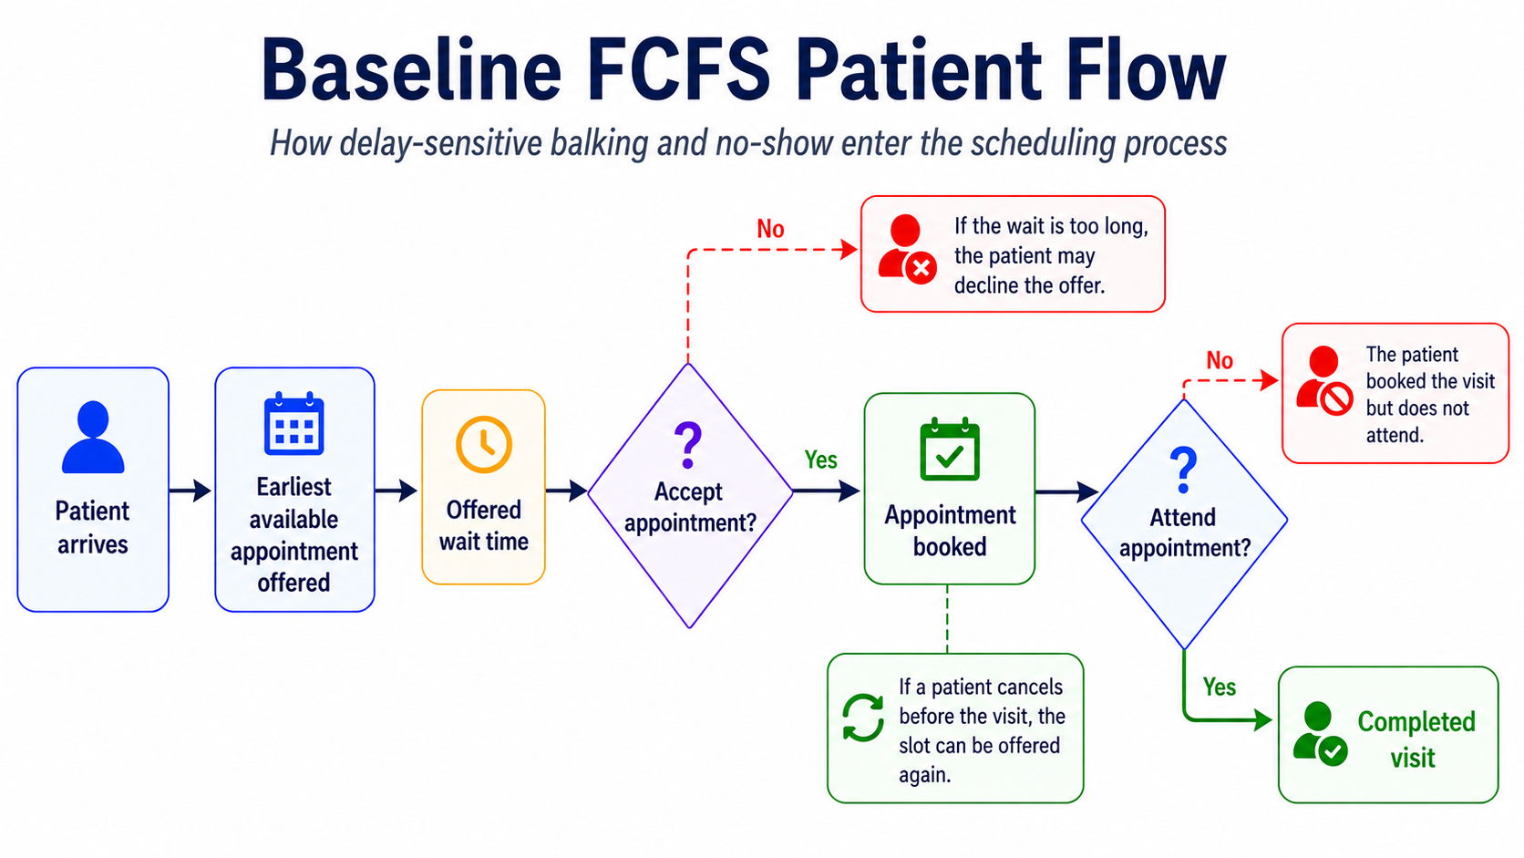
30 day burn-in 365-day measurement period 10-day cooldown

Slide 5
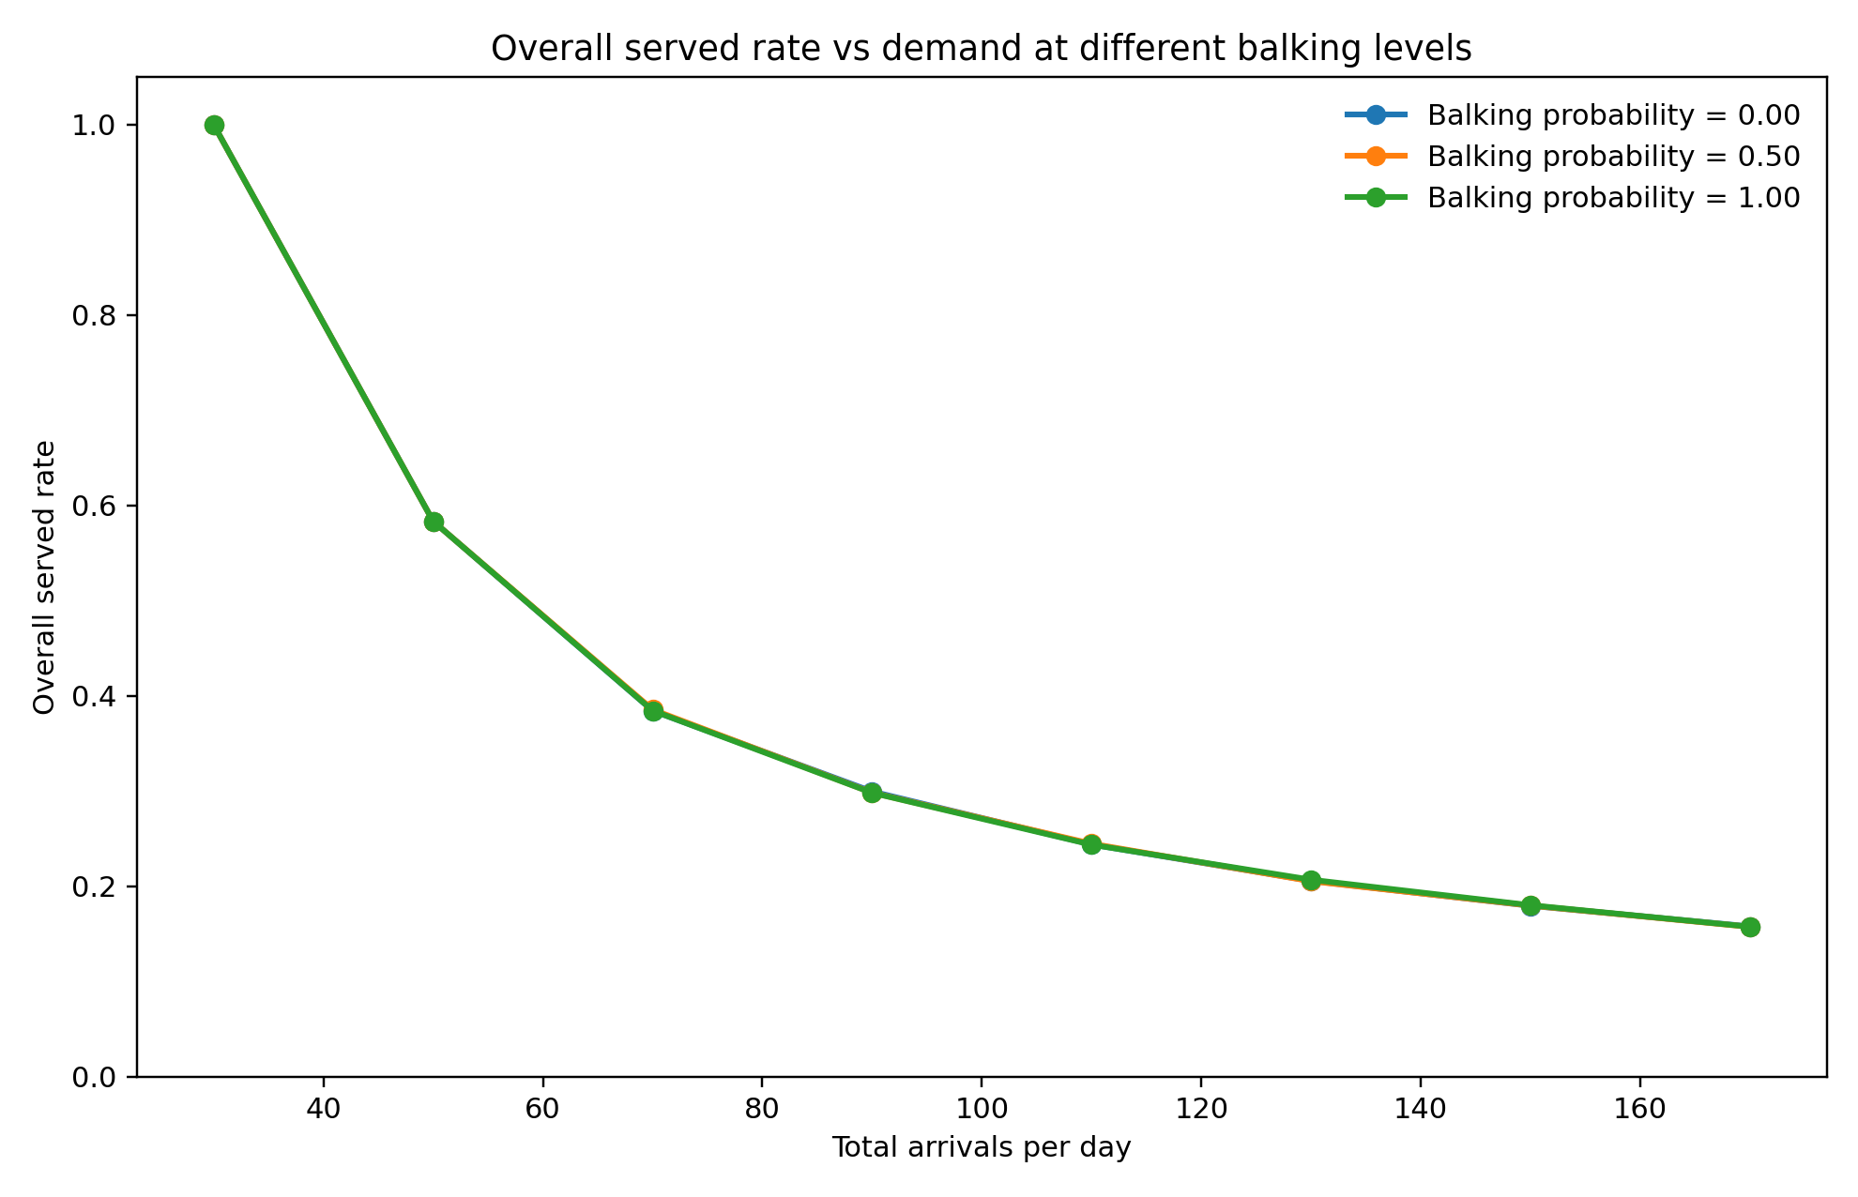
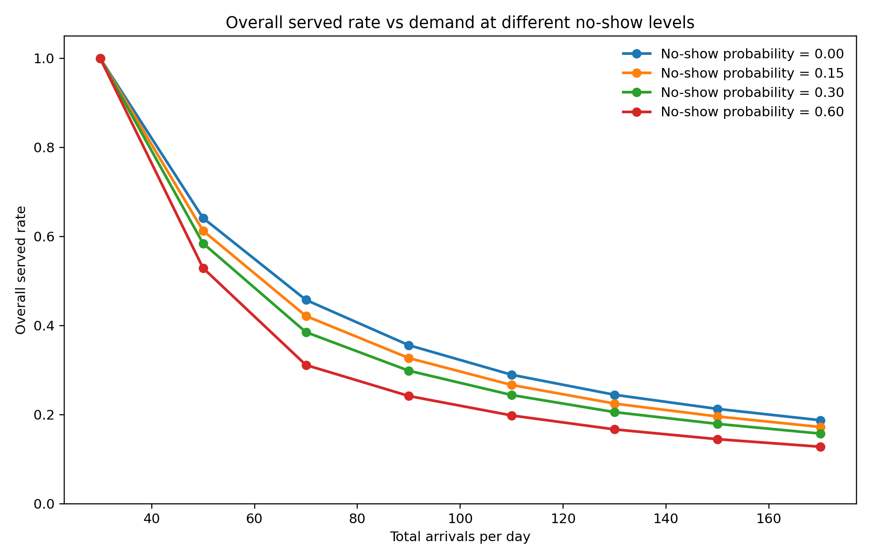
Demand is a big driver of served rate compounded by no-show
Under high demand, arrival becomes the main driver for served rate.
Balking rate has minimal effects while no-show further drives down served rate.

Slide 6
Threshold mechanisms: magnitude and delay
For both no-show and balking behavior of both classes
Magnitude and delay for probability and threshold

Slide 7
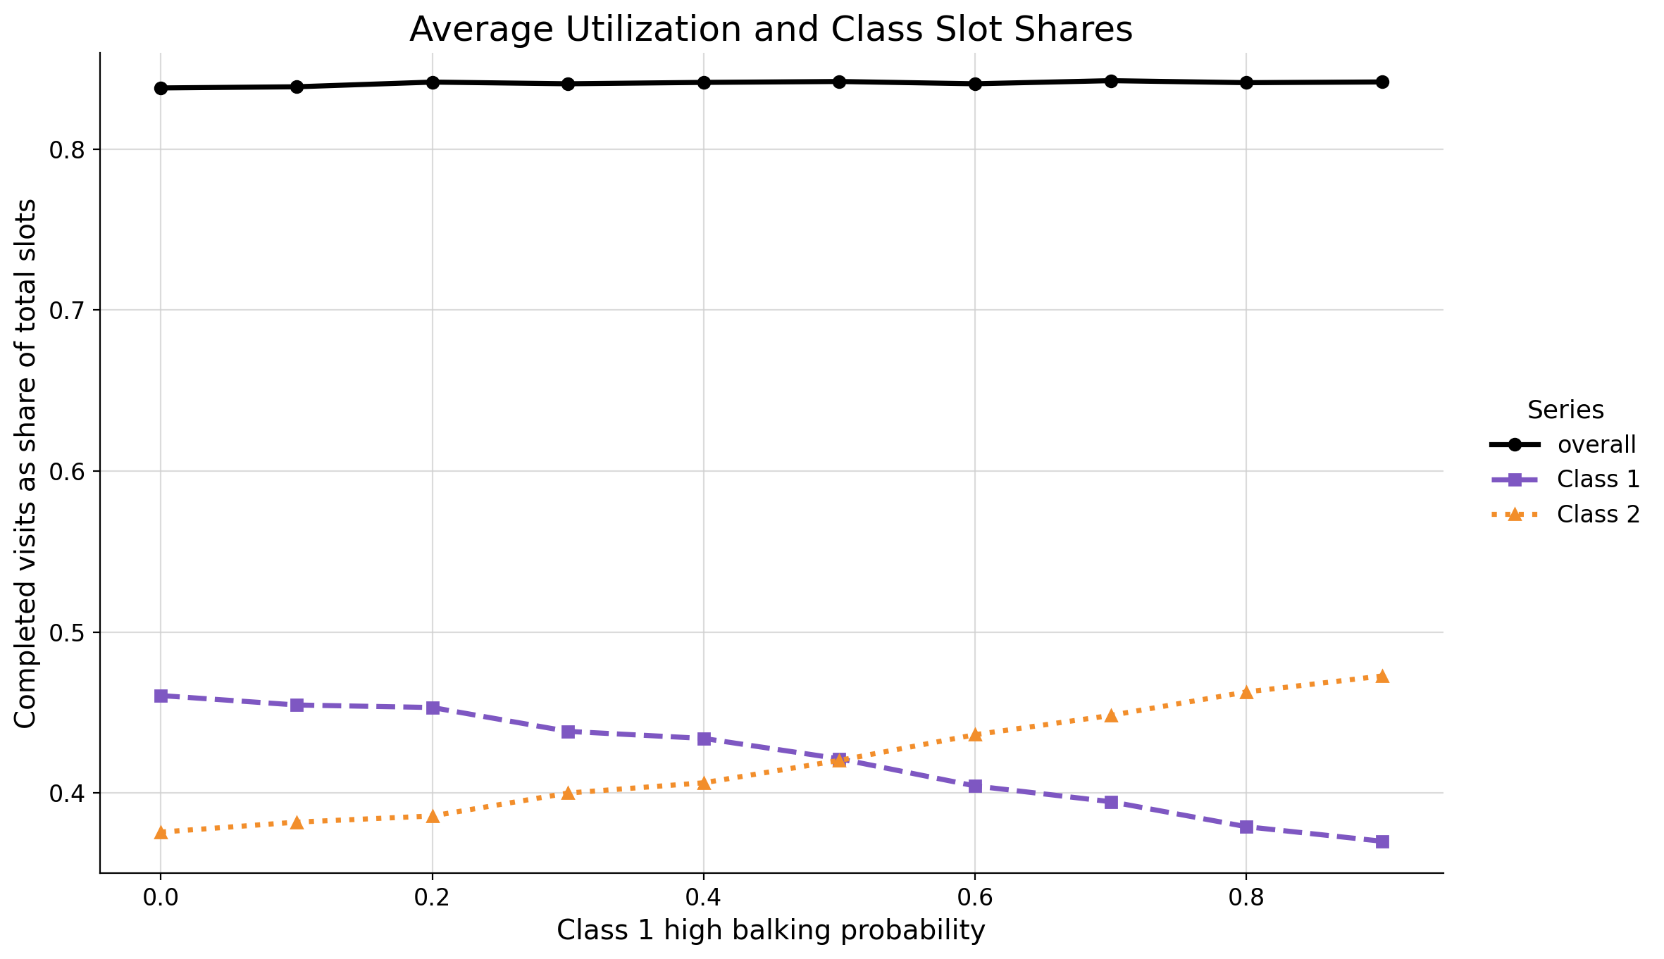
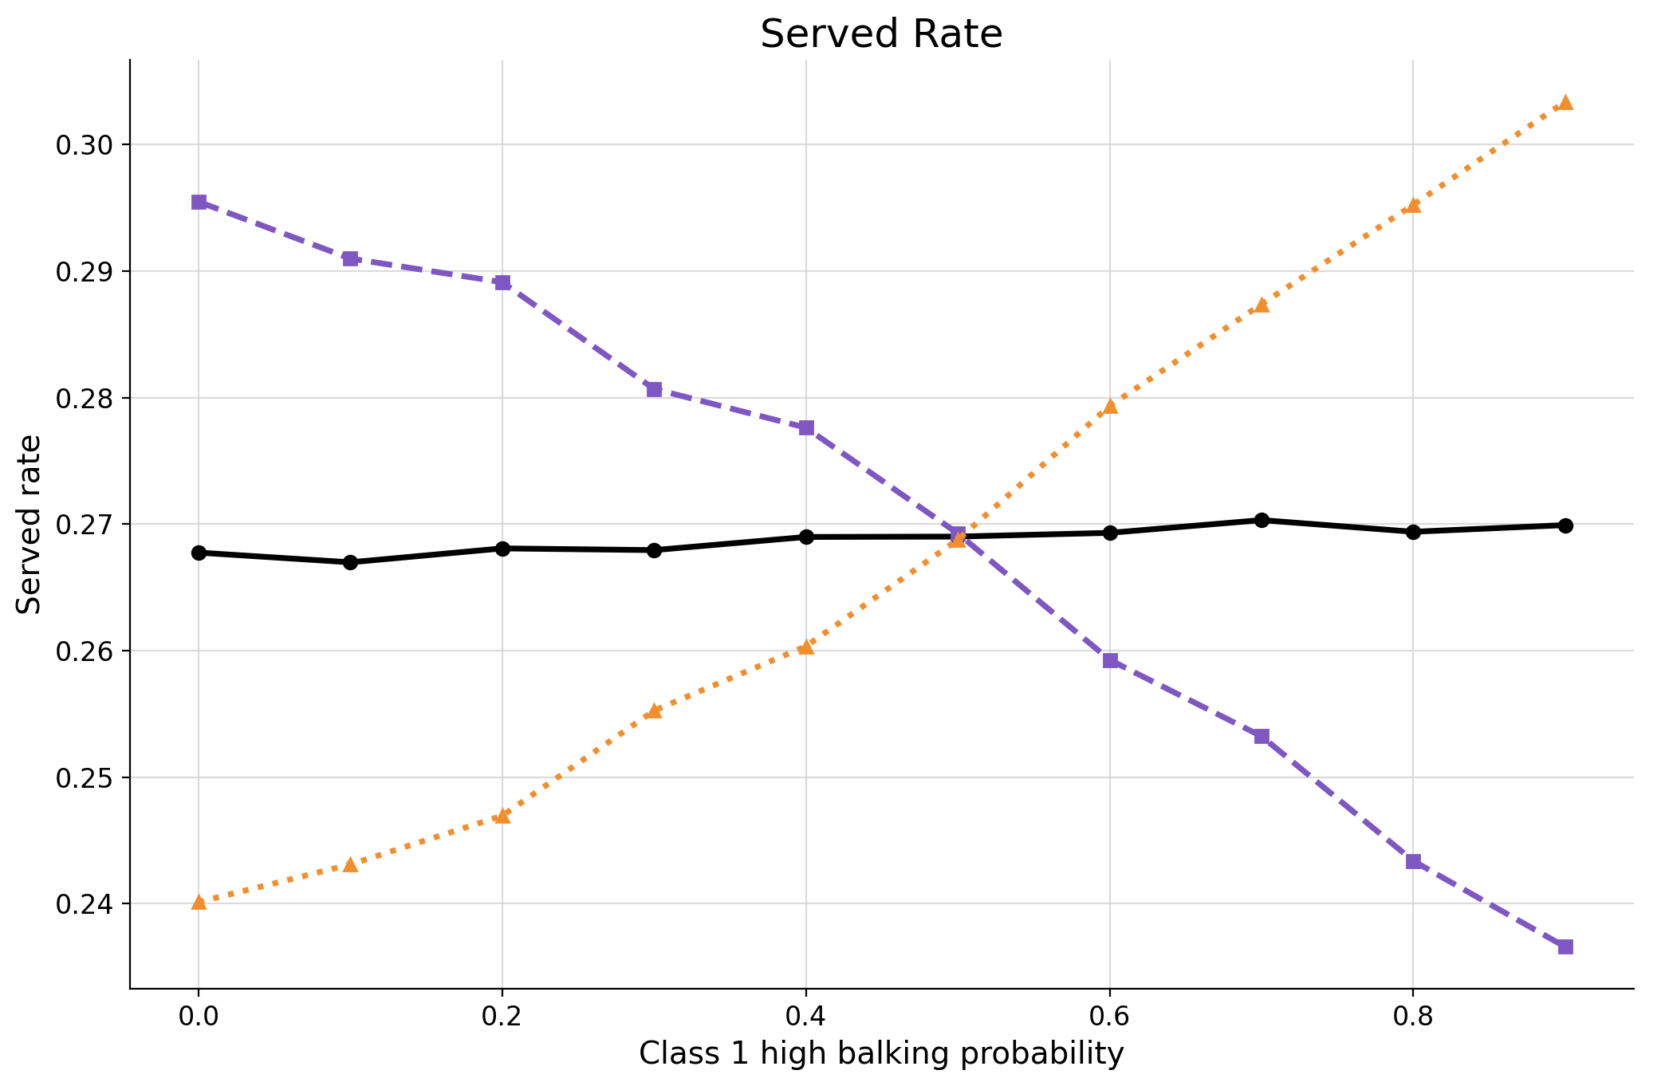
Under heavy demand, balking magnitude shifts appointments to the more wait-tolerant group
Overall utilization and served rate is not impacted by balking magnitude.
The wait-tolerant group takes over balked slots.

Slide 8
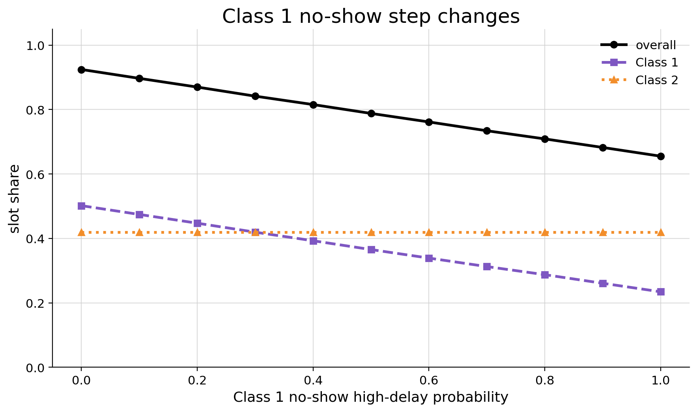
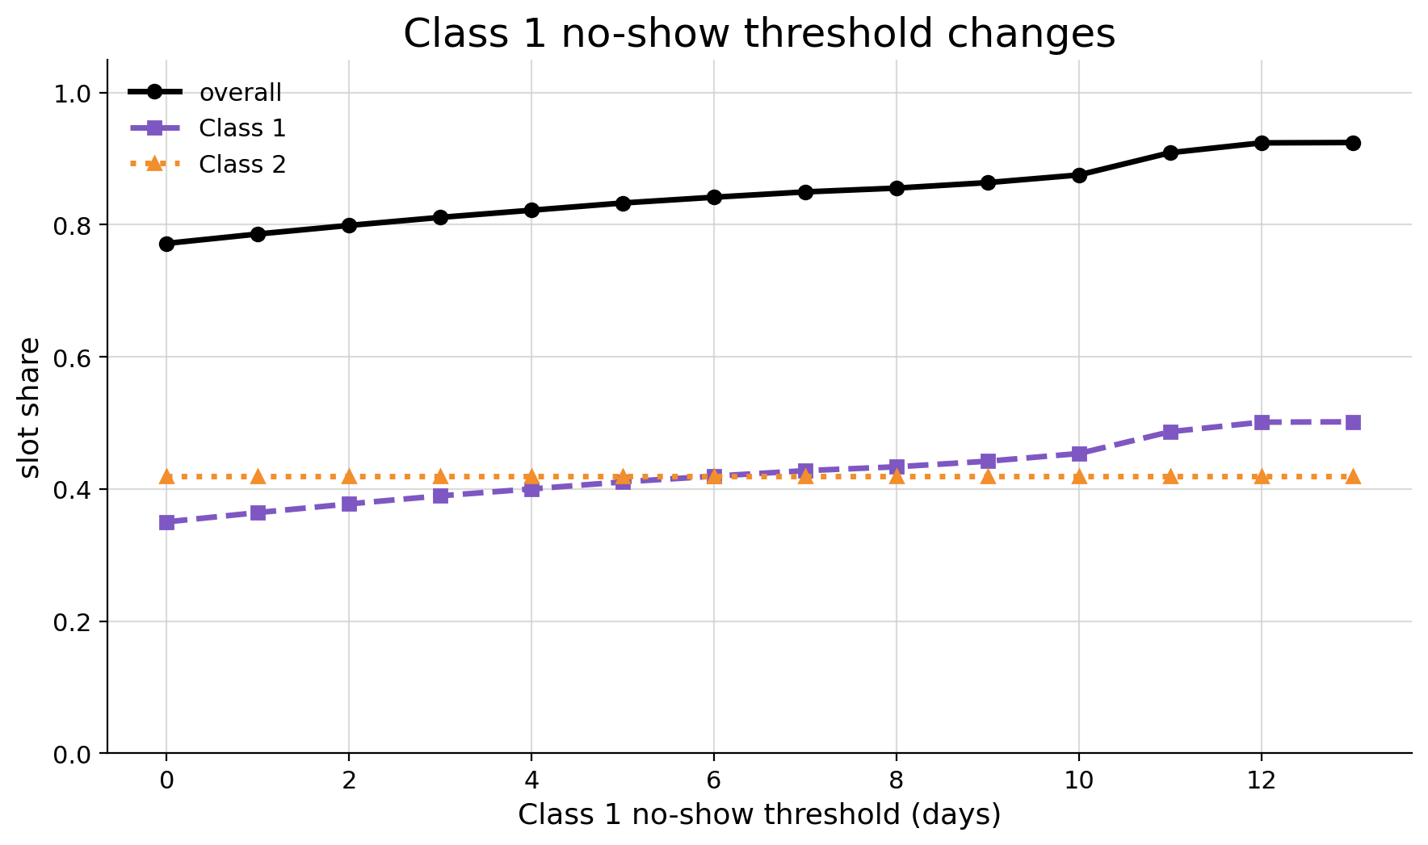
No-shows reduce average utilization and cause unrecoverable loss
Magnitude – post threshold probability
Delay – threshold
In addition to the magnitude of no-show and balking, the delay also matters.
For example, no-show threshold changes let more/less bookings fall before the no-show threshold.

Slide 9
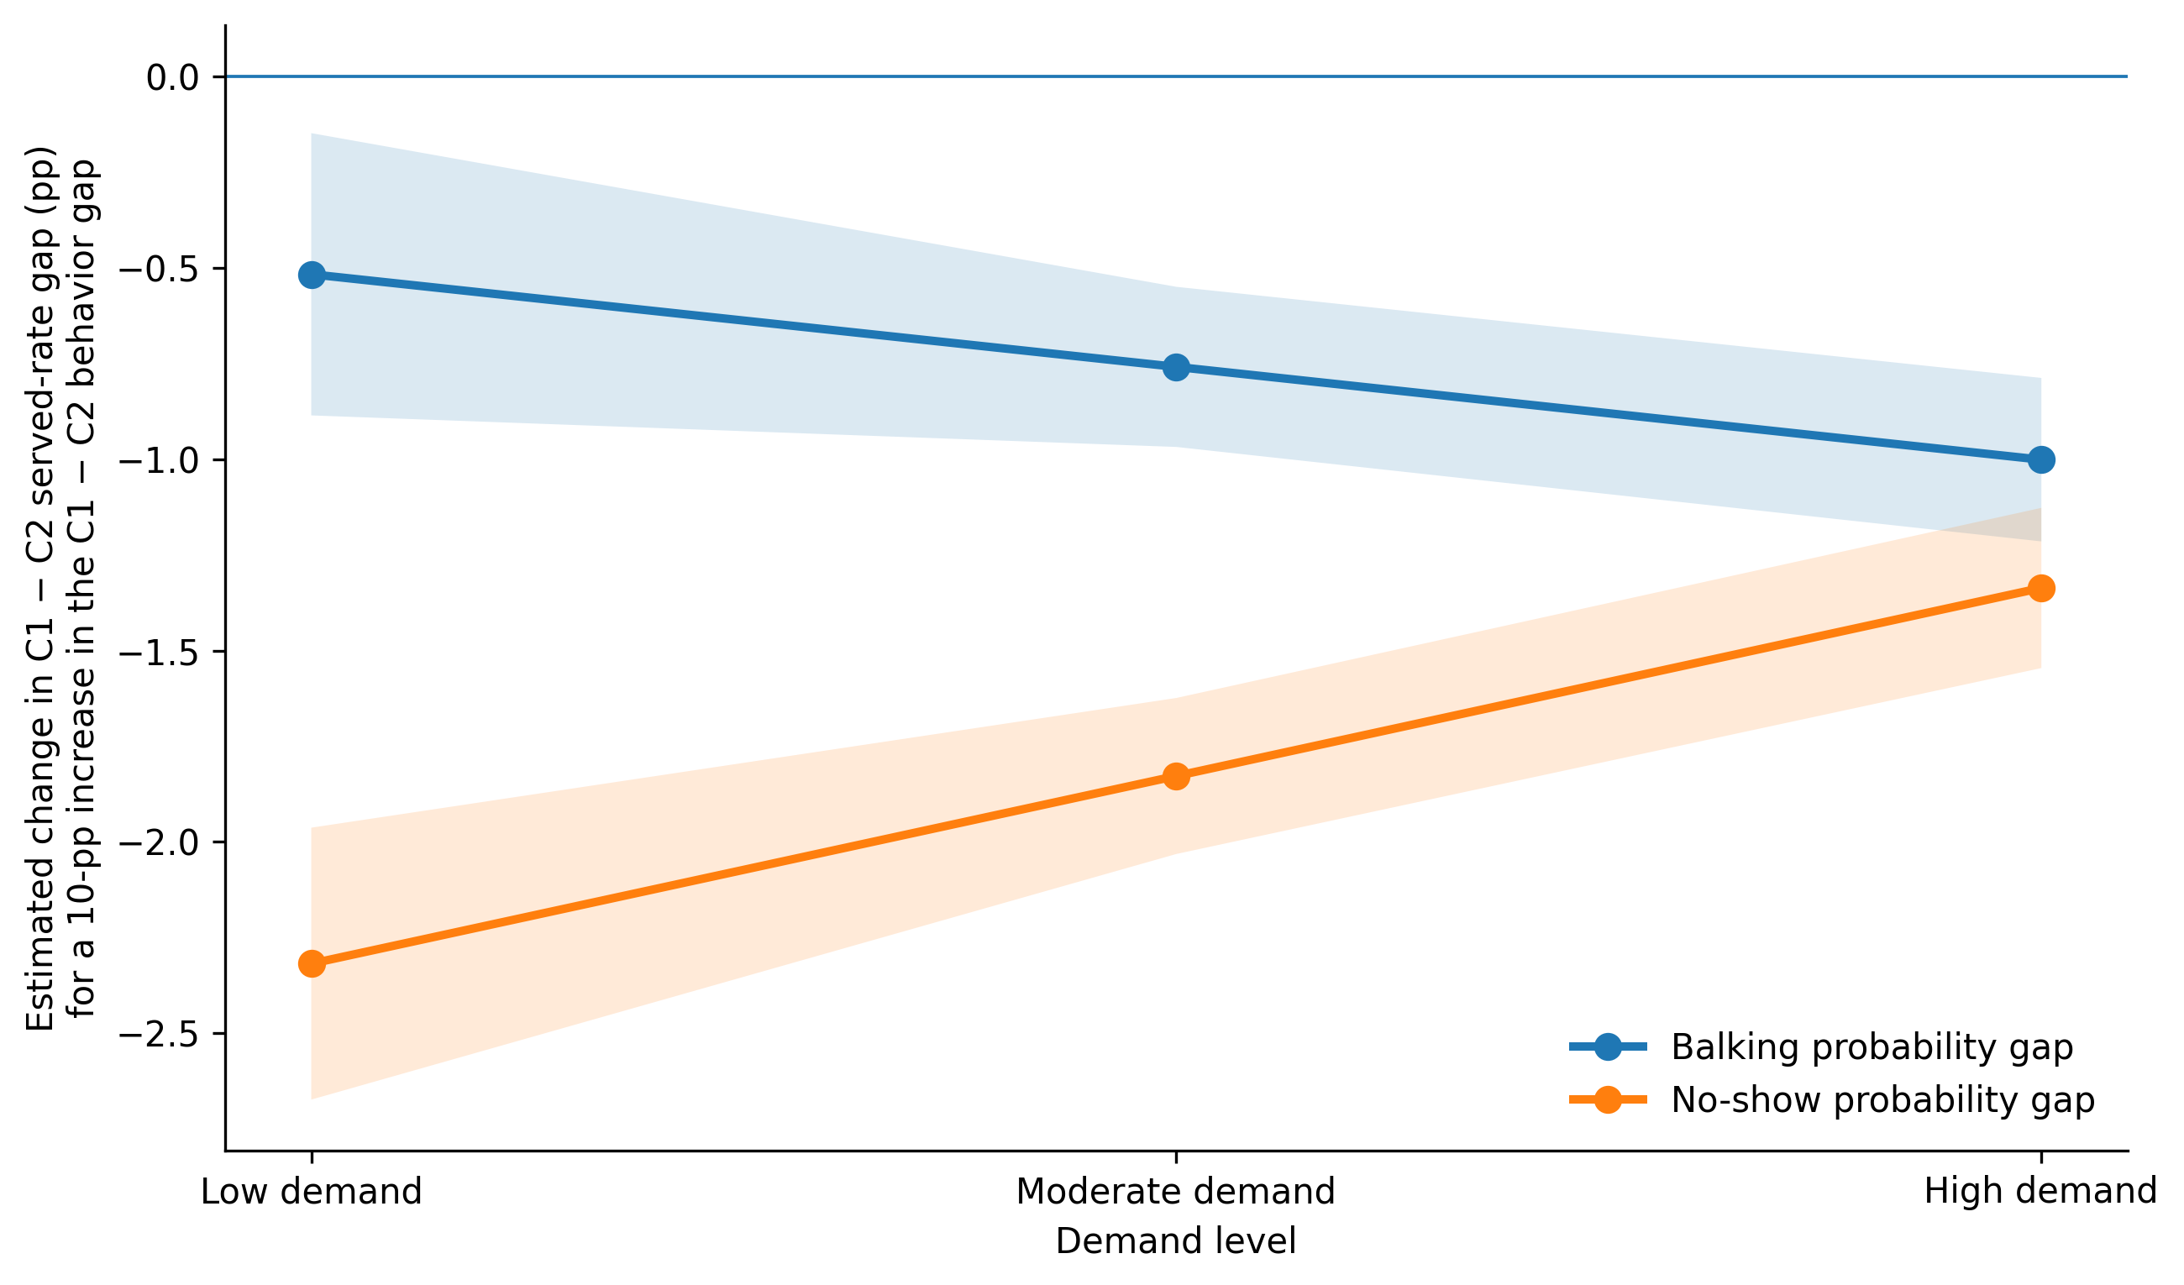
No-show is the stronger driver of class access, but balking becomes more important as demand increases
The served rate gap difference from making Class 1 more delay-sensitive shows opposing trends over demand.
The increase in no-show magnitude of class 1 lowers served rate gap more than an identical increase in balking.
Notes:
Class 1 is the delay sensitive class, difference in served rate between class 1 and class 2 – on y axis

Slide 10
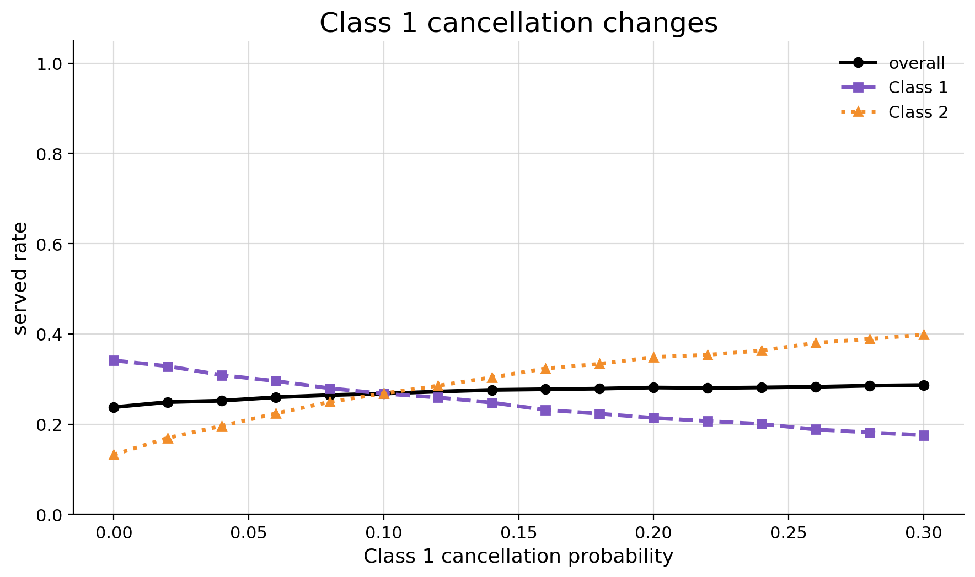
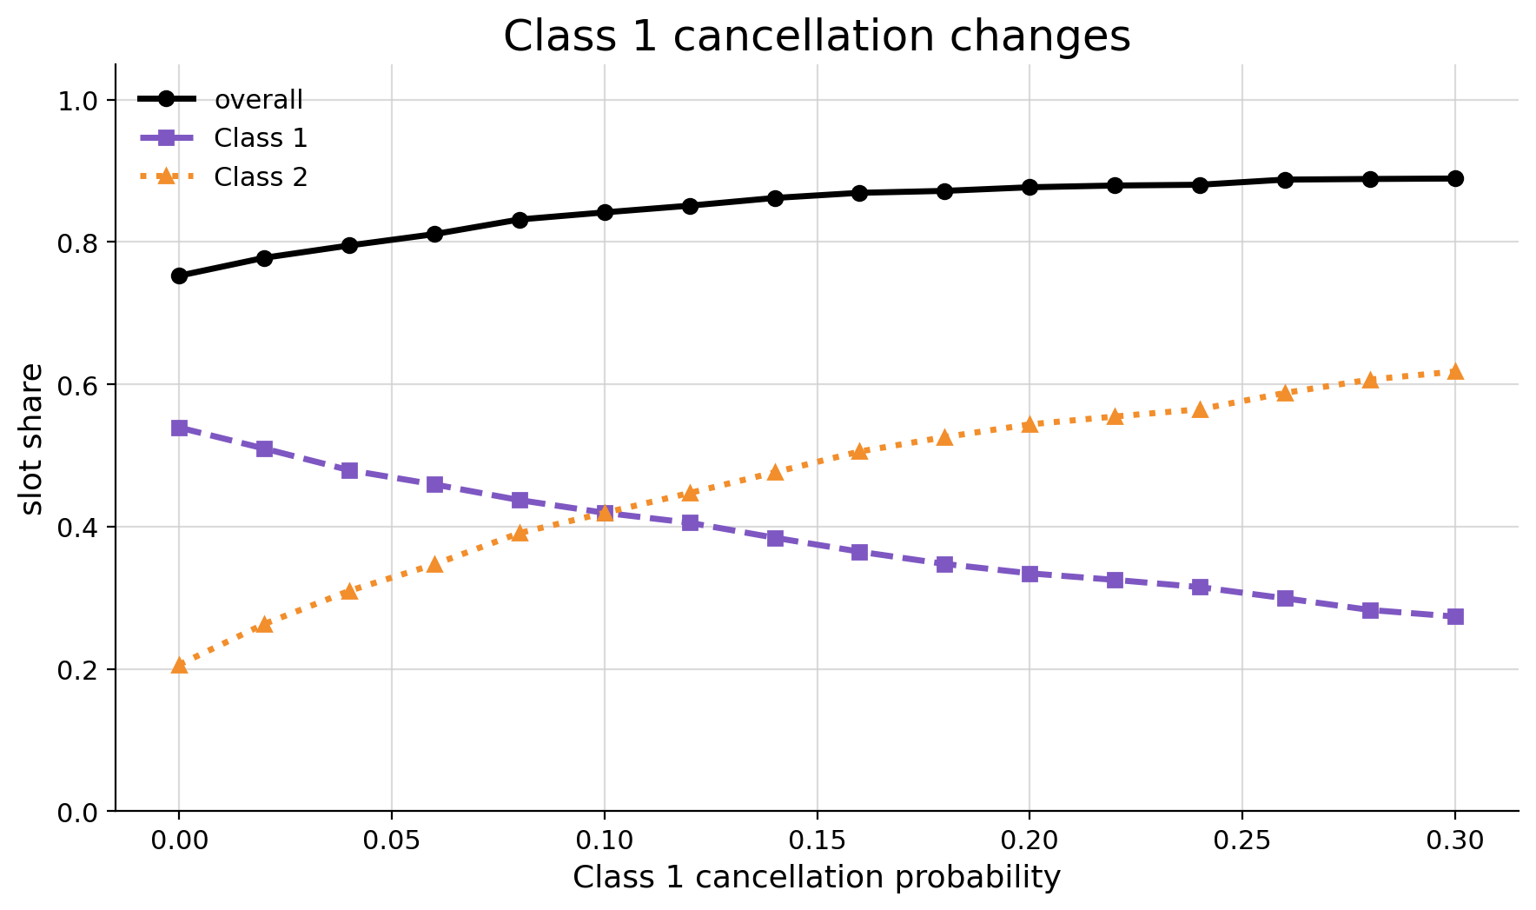
Cancellation redistributes access and does not waste capacity
Under high demand, cancellations transfer access from one class to the other without significant pooled changes.
Higher cancellation rate can improve utilization and waiting time by allowing appointments to be booked before behavior thresholds.

Slide 11
Summary
Demand is a big driver of served rate compounded by no-show.
Balking magnitude mainly redistributes access away from the delay-sensitive group.
No-shows cause unrecoverable loss and waste capacity.
Delay sensitivity matters along with behaviour magnitude.
No-show magnitude is the stronger driver of class access while balking becomes more important as demand increases
Cancellation redistributes access and service between classes.

Slide 12
Next Step: can scheduling policy reduce harm?
Explore the impact of patient behavior on utilization, served rate, and waiting time when the booking horizon is flexible.
Discover how to optimize metrics by choosing reservation slots and reservation period.
What are the win-win situations of class access and efficiency when policies become flexible?

Slide 13
Policies in consideration
Reservation
Allowing one class to have priority for certain appointments.
This policy chooses both reserved slots per day and reservation horizon.
2. Booking horizon
Adjusting how early an appointment booking is allowed.

